Slide 1





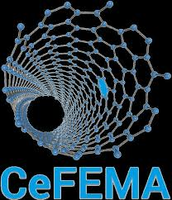
Novel Variational Quantum Algorithms for MaxCut
Author: Afonso Sequeira Azenha^{1,2,3}
afonso.azenha@tecnico.ulisboa.pt
Supervisor: Yasser Rashid Revez Omar^{1,2,3}
^{yasser.omar@tecnico.ulisboa.pt}
1- Instituto Superior Técnico, Universidade de Lisboa, Portugal
2- Portuguese Quantum Institute (PQI), Portugal
3- Physics of Information and Quantum Technologies Group, Centro de Física e Engenharia de Materiais Avançados (CeFEMA), Portugal

Slide 2
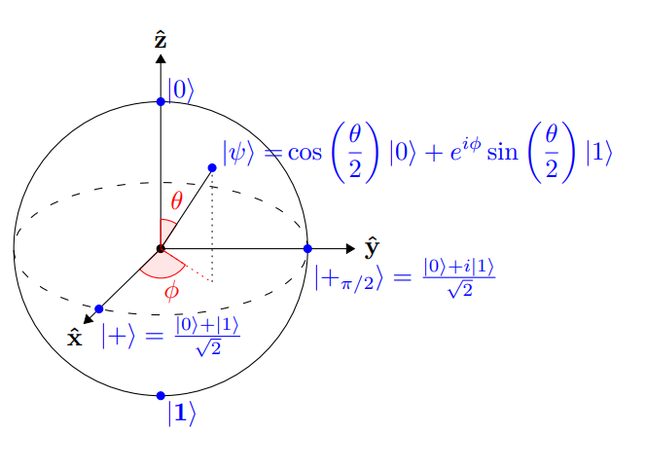
Index
Explaining the title:
MaxCut;
Quantum computing;
Variational quantum algorithms;
iQAQE Framework.
iQAQE Framework – Schemes and results:
Polynomial compression-based;
Extended-QEMC;
ND-CNOT-based ansätze;
Bigger graphs.
Machine-learning-based “mapping” model;
Alternative schemes;
Conclusions and future work.
Bloch sphere

Slide 3
Explaining the title
Novel Variational Quantum Algorithms for MaxCut

Slide 4
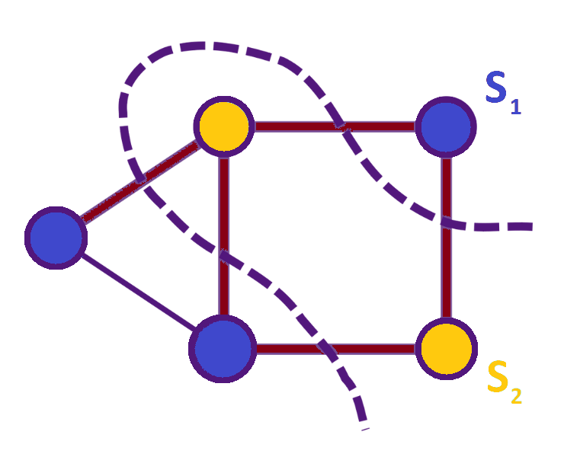
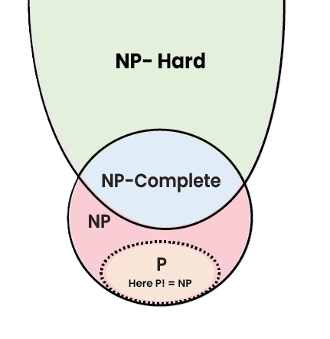
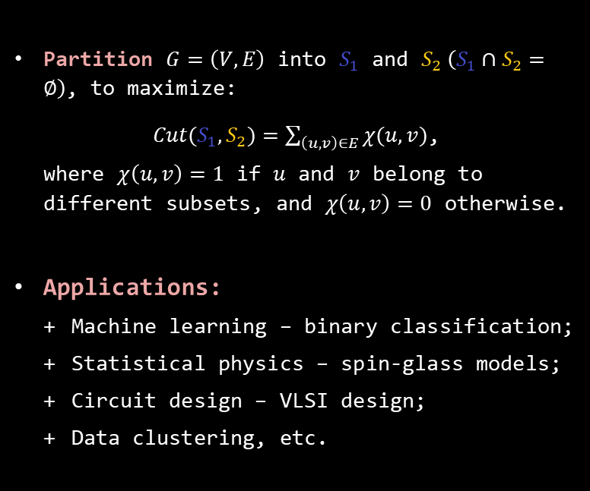
Maximum Cut problem (MaxCut)
Computational Complexity
MaxCut is NP-Hard;
Other NP problems:
Integer factorization;
Knapsack problem;
Travelling salesman problem, etc.
Partition $G=\left(V,E\right)$ into $S_{1}$ and $S_{2} \left(S_{1}∩S_{2}=∅\right)$, to maximize:
${Cut(S}_{1}, S_{2})=\sum_{\left(u,v\right)∈E}{χ(u,v)}$,
where $χ\left(u,v\right)=1$ if $u$ and $v$ belong to different subsets, and $χ\left(u,v\right)=0$ otherwise.
Applications:
Machine learning – binary classification;
Statistical physics – spin-glass models;
Circuit design – VLSI design;
Data clustering, etc.
MaxCut problem
Novel Variational Quantum Algorithms for MaxCut
Motivates the development of new algorithms.
Computational complexity classes

Slide 5
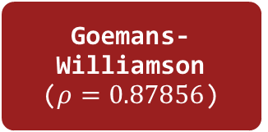
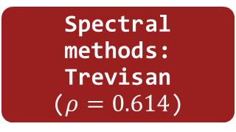
Maximum Cut problem (MaxCut) – State-of-the-art algorithms
Proposed algorithm
Goemans-Williamson ($ρ=0.87856$)
Classical (Approximation methods)
Spectral methods: Trevisan ($ρ=0.614$)
Novel Variational Quantum Algorithms for MaxCut
MaxCut algorithms
Quantum Approximate Optimization Algorithm (QAOA)
Hybrid quantum-classical
iQAQE Framework (Interpolation)
Qubit Efficient MaxCut Heuristc Algorithm (QEMC)

Slide 6
Explaining the title
Novel Variational Quantum Algorithms for MaxCut

Slide 7



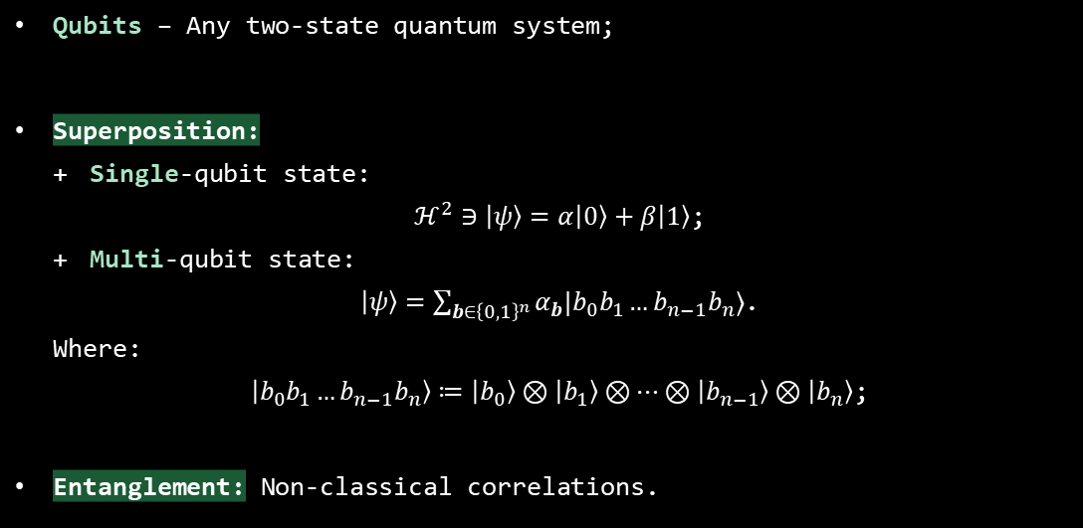
Quantum computing – General concepts
Qubits – Any two-state quantum system;
Superposition:
Single-qubit state:
$ℋ^{2}∋\left|ψ\right\rangle =α\left|0\right\rangle +β\left|1\right\rangle$;
Multi-qubit state:
$\left|ψ\right\rangle =\sum_{b∈{\left\{0,1\right\}}^{n}}{α_{b}|b_{0}b_{1}…b_{n−1}b_{n}⟩}$.
Where:
$\left|b_{0}b_{1}…b_{n−1}b_{n}\right\rangle ≔\left|b_{0}\right\rangle ⊗\left|b_{1}\right\rangle ⊗…⊗\left|b_{n−1}\right\rangle ⊗\left|b_{n}\right\rangle$;
Entanglement: Non-classical correlations.
Speed-ups!
Novel Variational Quantum Algorithms for MaxCut

Slide 8
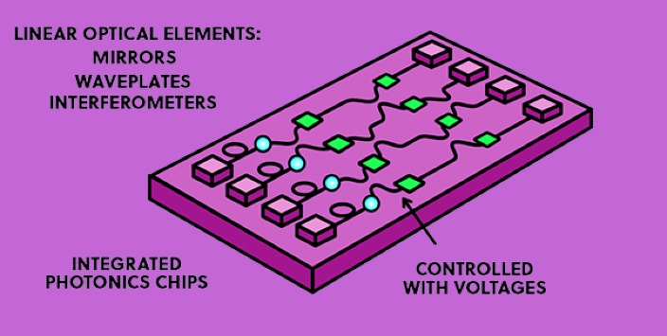
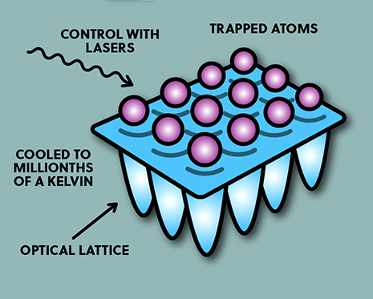

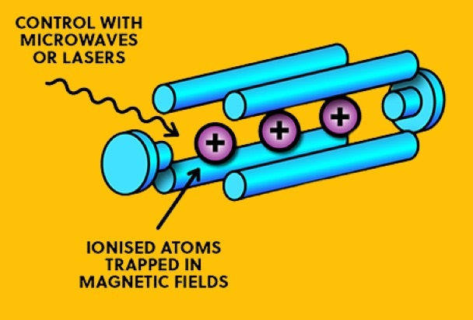

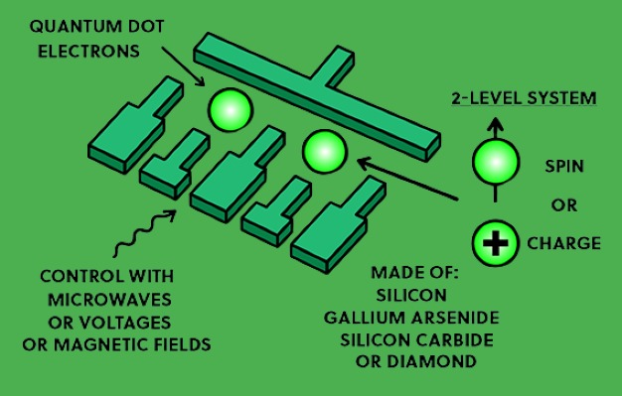

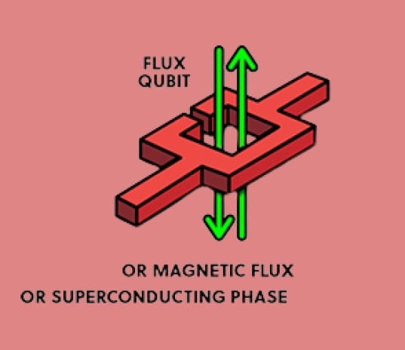

Quantum computing – Types of qubits
Types of qubits – physical implementations:
Photonic;
Neutral atoms (using Rydberg states);
Trapped ions;
Semiconductors;
Superconducting circuits;
Etc.
Source: Domain of Science - Dominic Walliman
Novel Variational Quantum Algorithms for MaxCut

Slide 9
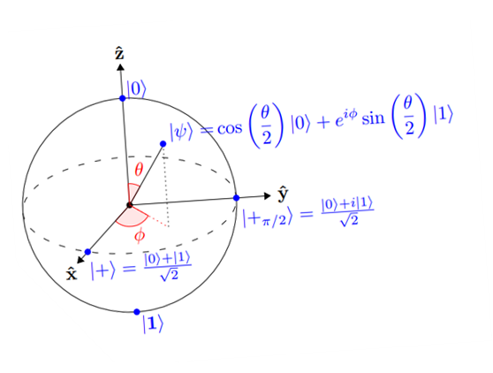
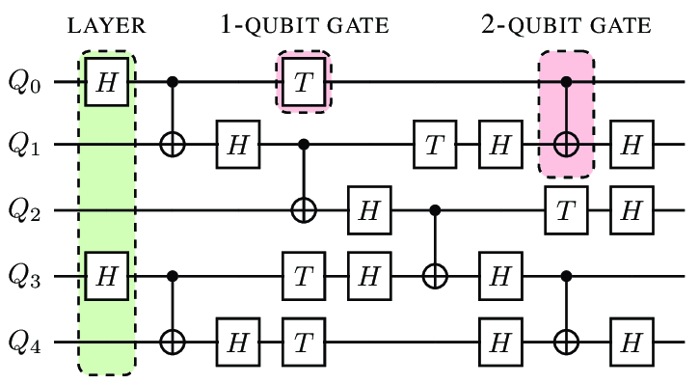
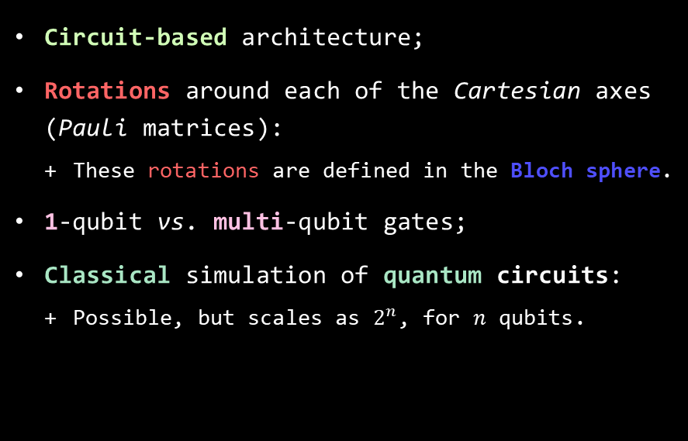
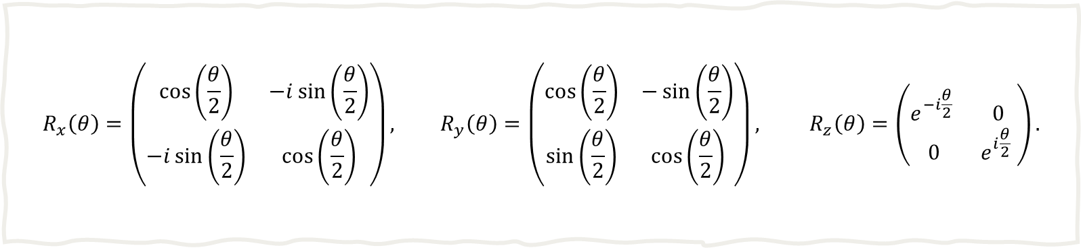
Quantum computing – Quantum circuits
$$R_{x}\left(θ\right)=\left(\begin{matrix}\cos\left(\frac{θ}{2}\right) & −i\sin\left(\frac{θ}{2}\right) \\ −i\sin\left(\frac{θ}{2}\right) & \cos\left(\frac{θ}{2}\right)\end{matrix}\right), R_{y}\left(θ\right)=\left(\begin{matrix}\cos\left(\frac{θ}{2}\right) & −\sin\left(\frac{θ}{2}\right) \\ \sin\left(\frac{θ}{2}\right) & \cos\left(\frac{θ}{2}\right)\end{matrix}\right), R_{z}\left(θ\right)=\left(\begin{matrix}e^{−i\frac{θ}{2}} & 0 \\ 0 & e^{i\frac{θ}{2}} \end{matrix}\right).$$
Bloch sphere illustration
Circuit-based architecture;
Rotations around each of the Cartesian axes (Pauli matrices):
These rotations are defined in the Bloch sphere.
1-qubit vs. multi-qubit gates;
Classical simulation of quantum circuits:
Possible, but scales as $2^{n}$, for $n$ qubits.
Single-qubit rotation gates
Quantum circuit example
Novel Variational Quantum Algorithms for MaxCut

Slide 10
Explaining the title
Novel Variational Quantum Algorithms for MaxCut

Slide 11
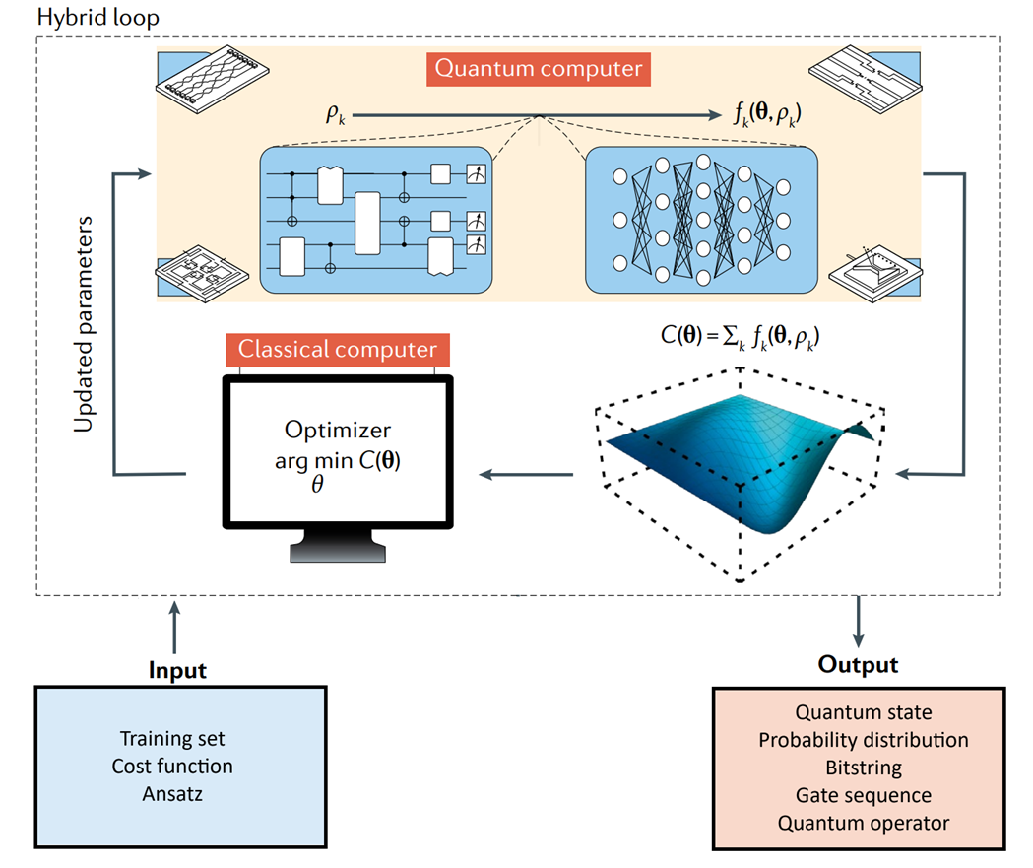
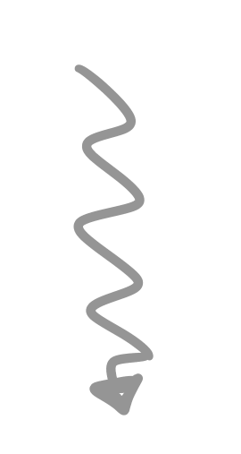
Hybrid Quantum-Classical Computing
Parameters
Combines both classical and quantum computing elements;
Allows for error mitigation;
Shallower quantum circuits ⟹ less hardware noise;
Variational Quantum Algorithms (VQAs) – Using parameterized quantum circuits;
Many, many prospective applications.
Novel Variational Quantum Algorithms for MaxCut
HQCC:
Hybrid-loop framework [1].
[1] - M. Cerezo et al. “Variational quantum algorithms”. In: Nature Reviews Physics 3.9 (Aug. 2021), 625–644.

Slide 12
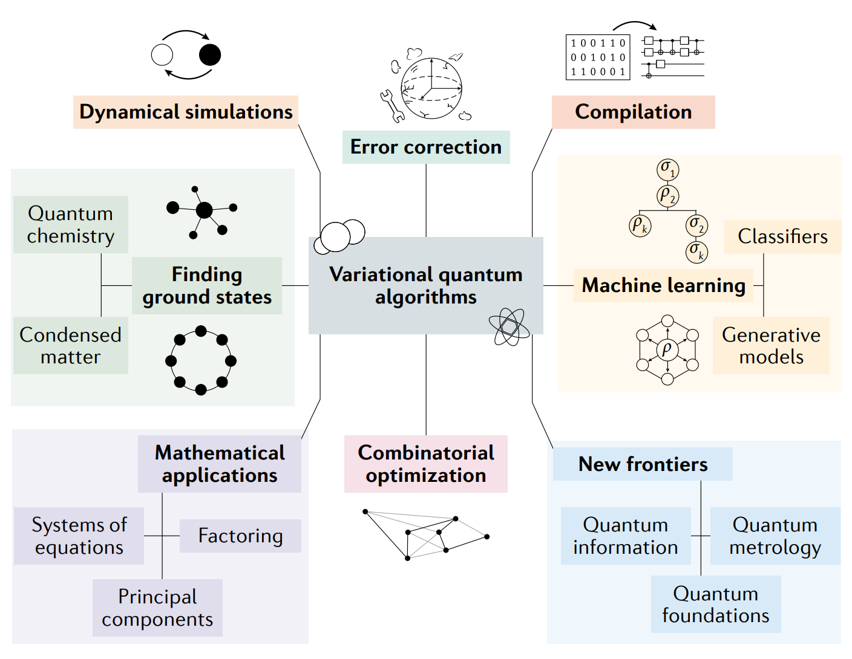
Variational Quantum Algorithms - Applications
Novel Variational Quantum Algorithms for MaxCut
VQAs: Applications. Taken from [1].
[1] - M. Cerezo et al. “Variational quantum algorithms”. In: Nature Reviews Physics 3.9 (Aug. 2021), 625–644.

Slide 13
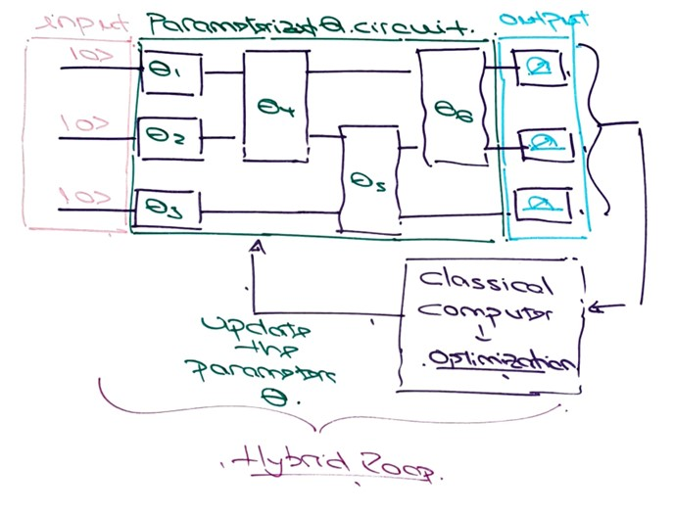


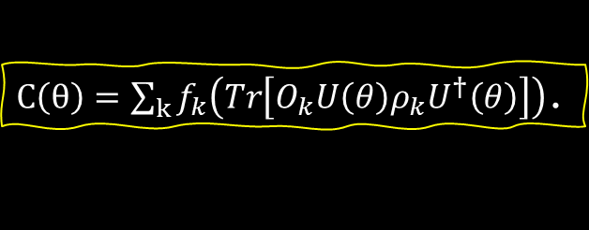
VQAs – Basic structure
VQAs solve the optimization task [1]:
Basic VQA structure:
Cost function – To be minimized:
Ansatz – Quantum circuit form:
Problem-inspired vs. problem-agnostic;
Gradients – Parameter-shift rule:
$θ^{⋆}=\arg{\min_{θ}{C(θ)}}$.
Novel Variational Quantum Algorithms for MaxCut
$C\left(θ\right)=\sum_{k}{f_{k}\left(Tr\left[O_{k}U\left(θ\right)ρ_{k}U^{†}\left(θ\right)\right]\right)}$.
Training – Hybrid loop
$\frac{∂C}{∂θ_{l}}=\sum_{k}{\frac{1}{2\sin{α}}(Tr\left[O_{k}U\left(θ_{+}\right)ρ_{k}U^{†}\left(θ_{+}\right)\right]−Tr\left[O_{k}U\left(θ_{−}\right)ρ_{k}U^{†}\left(θ_{−}\right)\right] )}$.
[1] - M. Cerezo et al. “Variational quantum algorithms”. In: Nature Reviews Physics 3.9 (Aug. 2021), 625–644.
Notes:
# TODO: Change the training image! Done.

Slide 14
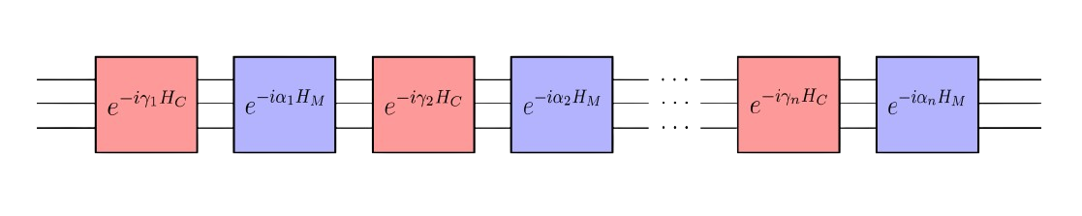
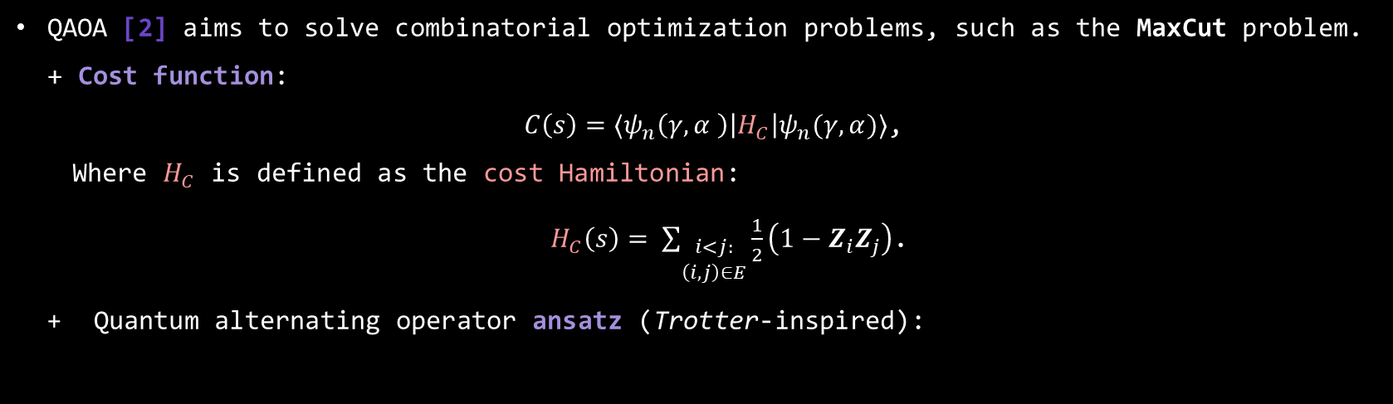
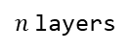
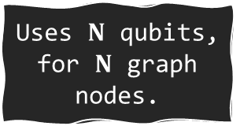
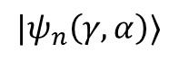
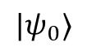
Quantum Approximate Optimization Algorithm (QAOA)
QAOA [2] aims to solve combinatorial optimization problems, such as the MaxCut problem.
Cost function:
$C\left(s\right)=⟨ψ_{n}\left(γ,α \right)\left|H_{C}\right|ψ_{n}(γ, α)⟩$,
Where $H_{C}$ is defined as the cost Hamiltonian:
$H_{C}\left(s\right)= \sum_{\begin{aligned}i<j: \\ \left(i, j\right)∈E\end{aligned}}{\frac{1}{2}\left(1−Z_{i}Z_{j}\right)}$.
Quantum alternating operator ansatz (Trotter-inspired):
Uses $N$ qubits, for $N$ graph nodes.
Novel Variational Quantum Algorithms for MaxCut
$$|ψ_{0}⟩$$
$$|ψ_{n}\left(γ, α\right)⟩$$
$n$layers
With $H_{M}$, the mixer Hamiltonian: $H_{M}={(X_{j})}^{⨂n}$.
[2] - Edward Farhi, Jeffrey Goldstone, and Sam Gutmann. A Quantum Approximate Optimization Algorithm. 2014.

Slide 15
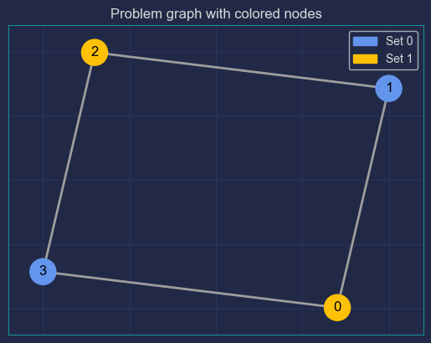
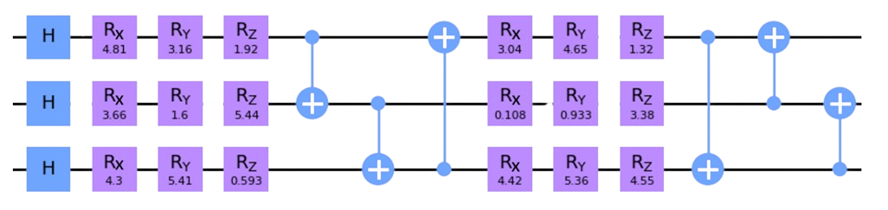
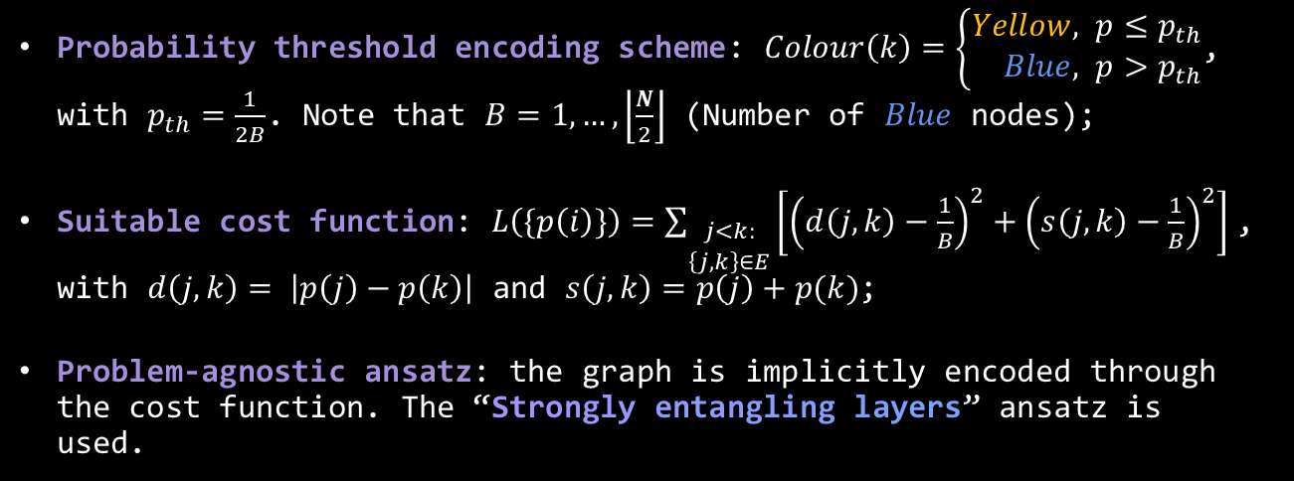

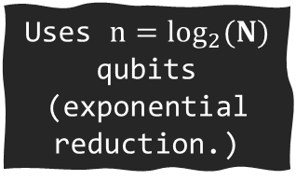
Qubit-Efficient MaxCut Heuristic Algorithm (QEMC)
Probability threshold encoding scheme: $Colour\left(k\right)=\left\{\begin{aligned}Yellow, &p≤p_{th} \\ Blue, &p>p_{th}\end{aligned}\right.$, with $p_{th}=\frac{1}{2B}$. Note that $B=1, …,\left\lfloor \frac{N}{2}\right\rfloor$ (Number of $Blue$ nodes);
Suitable cost function: $L\left(\{p\left(i\right)\}\right)=\sum_{\begin{aligned}j<k: \\ \left\{j, k\right\}∈E\end{aligned}}{\left[{\left(d\left(j, k\right)−\frac{1}{B}\right)}^{2}+{\left(s\left(j, k\right)−\frac{1}{B}\right)}^{2}\right]}$, with $d\left(j,k\right)= \left|p\left(j\right)−p\left(k\right)\right|$ and $s\left(j,k\right)=p\left(j\right)+p(k)$;
Problem-agnostic ansatz: the graph is implicitly encoded through the cost function. The “Strongly entangling layers” ansatz is used.
Novel Variational Quantum Algorithms for MaxCut
Uses $n=\log_{2}(N)$ qubits (exponential reduction.)
“Strongly entangling layers” ansatz: case with $n = 3$qubits and $p = 2$layers. Taken from [3].
[3] - Yovav Tene-Cohen et al. A Variational Qubit-Efficient MaxCut
Heuristic Algorithm. 2023.

Slide 16
Explaining the title
Novel Variational Quantum Algorithms for MaxCut

Slide 17
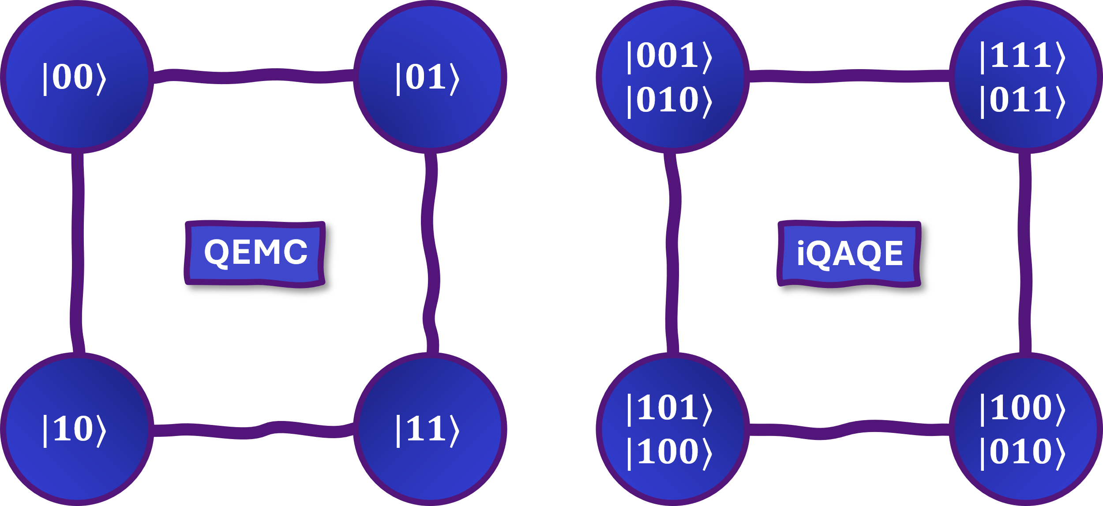
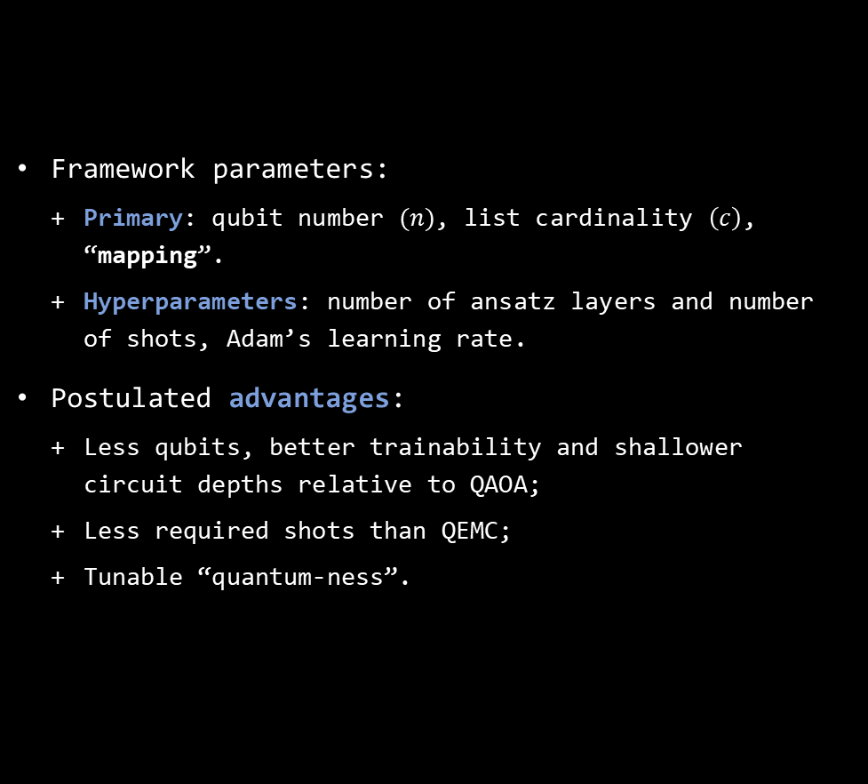
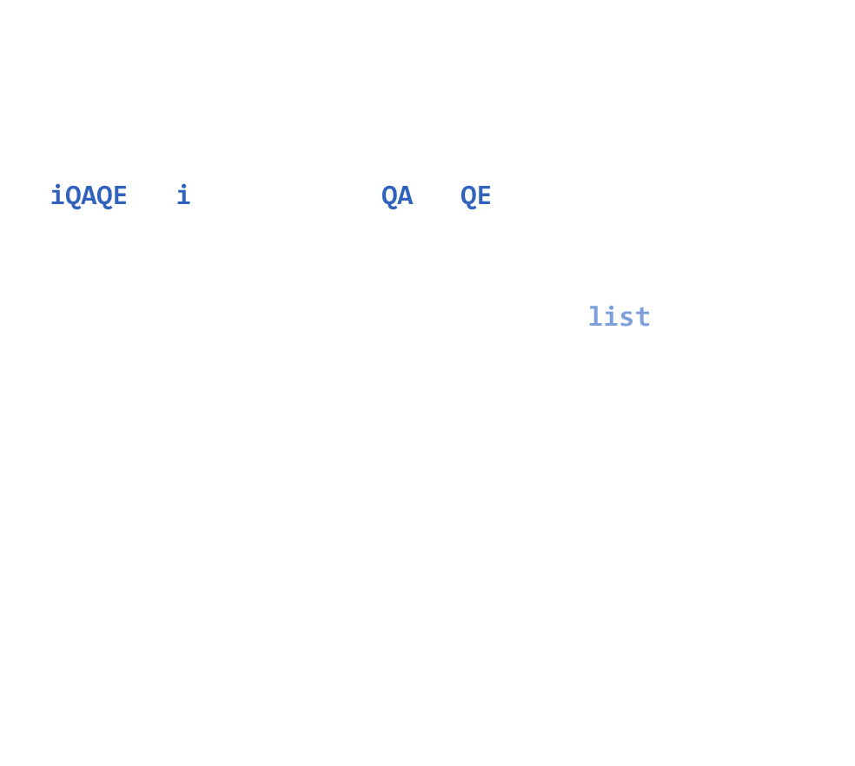
iQAQE Framework
iQAQE – interpolated QAOA/QEMC: Uses QEMC’s ansatz and cost ($B=\left\lfloor \frac{N}{2}\right\rfloor$ is used by default).
Associates each graph node with a list of basis states, not just $1$ basis state:
$c∈[1, 2^{n−1}]$, for $n$ qubits;
$n∈\left[\log_{2}\left(N\right),N\right]$;
Node probabilities are computed by the normalized sum of their associated basis states’ probabilities.
Framework parameters:
Primary: qubit number $(n)$, list cardinality $\left(c\right)$, “mapping”.
Hyperparameters: number of ansatz layers and number of shots, Adam’s learning rate.
Postulated advantages:
Less qubits, better trainability and shallower circuit depths relative to QAOA;
Less required shots than QEMC;
Tunable “quantum-ness”.
Novel Variational Quantum Algorithms for MaxCut
Notes:
Framework parameters: Primary – these define the VQA itself, from the framework; Hyperparameters – these can be fine-tuned for better performance. (Shot number is a bit of an “outlier”, in that you don’t really tune it, but it is not a “Primary” parameter, so I include it here. It’s used more so to assess how the algorithm would perform in a real-world setting, where we’re required to sample the quantum circuit a finite number of times.)

Slide 18
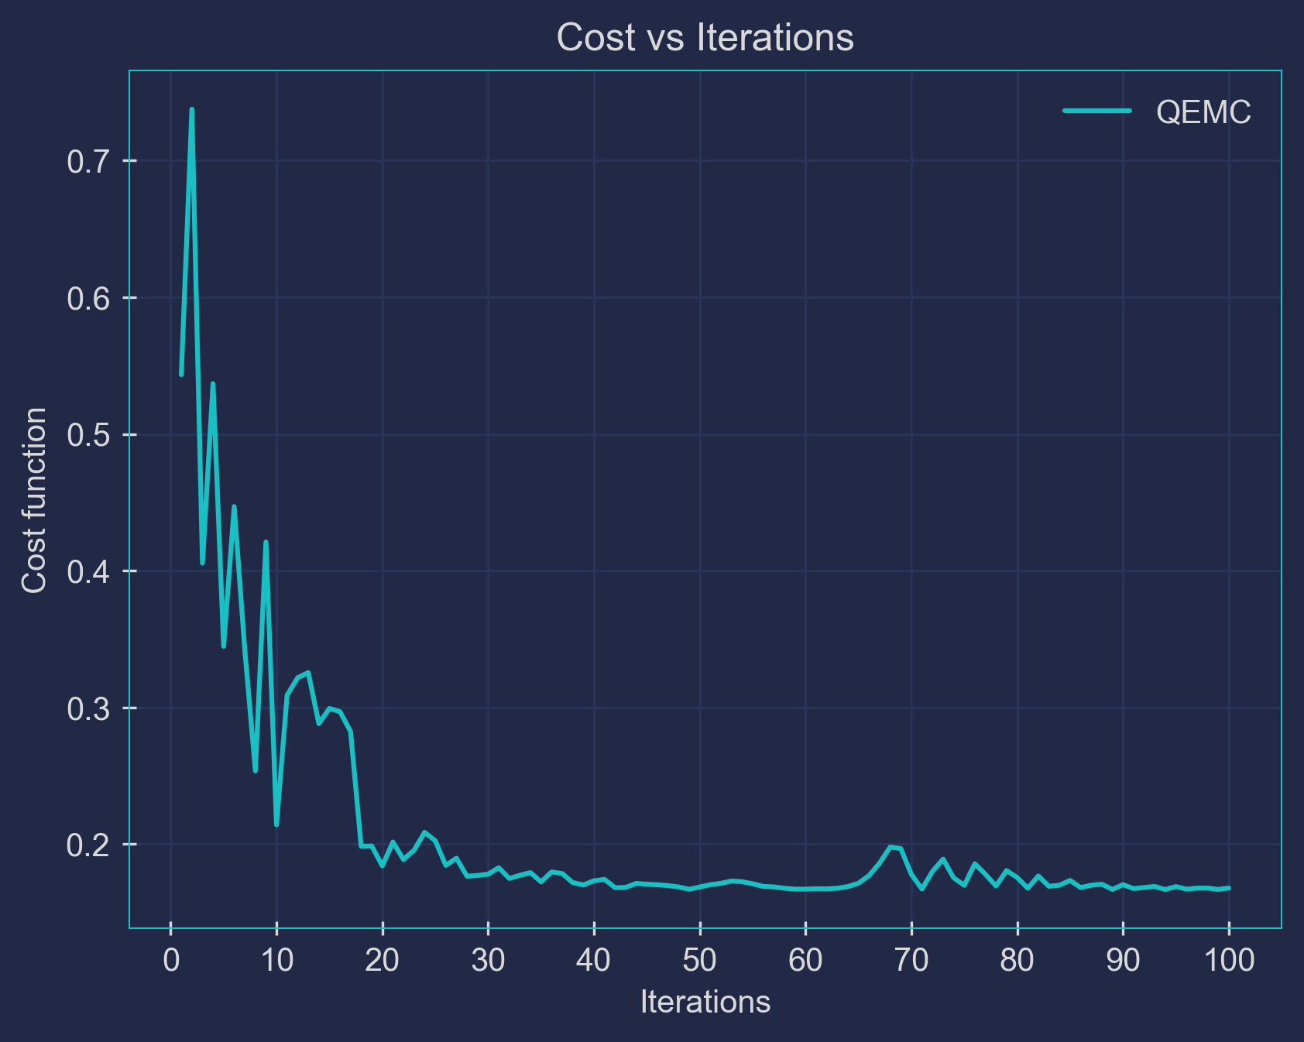
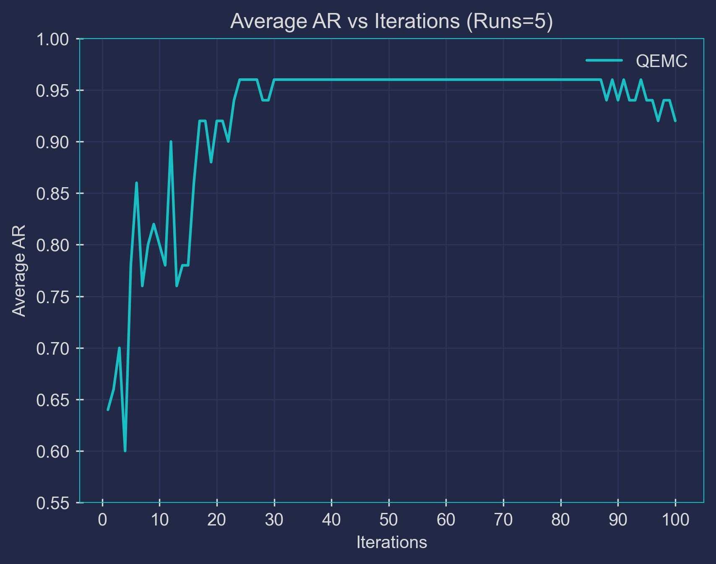
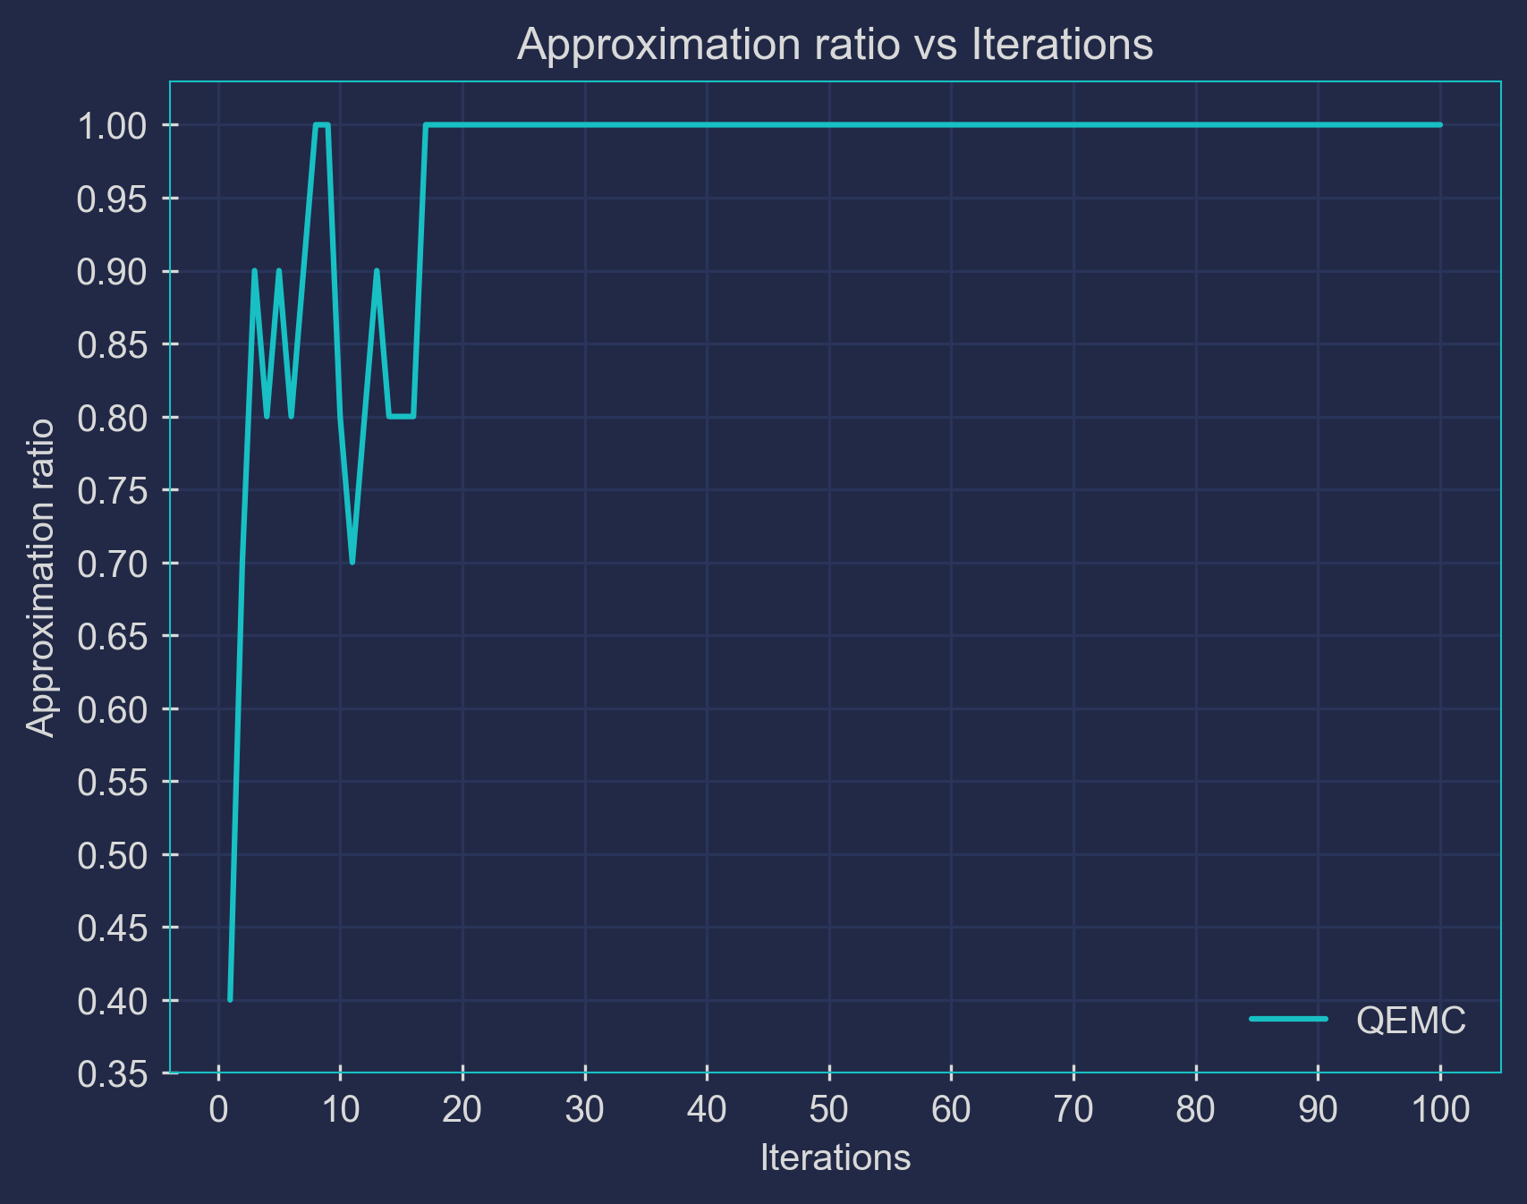
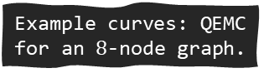
Implementation
Example curves: QEMC for an $8$-node graph.
Python libraries:
PennyLane (quantum programming);
NetworkX (graph manipulation);
CVXPY (convex optimization).
Performance metrics:
Training curves: cost and approximation ratio plots (vs. iterations);
Statistically robust metrics:
Average curves;
Average/Median best-so-far curves;
Best-so-far average curves.

Slide 19

iQAQE Schemes and Results
Developed schemes:
Random iQAQE;
Polynomial compression-type encodings:
Basic polynomial compression-type iQAQE;
QAOA-limit;
Correlation-based iQAQE;
Fixed-parity iQAQE.
Extended-QEMC:
Unmodified Extended-QEMC;
Cardinality $=1$ Extended-QEMC.
Alternative ansätze;
Goemans-Williamson & bigger graphs.
Focus on these!

Slide 20
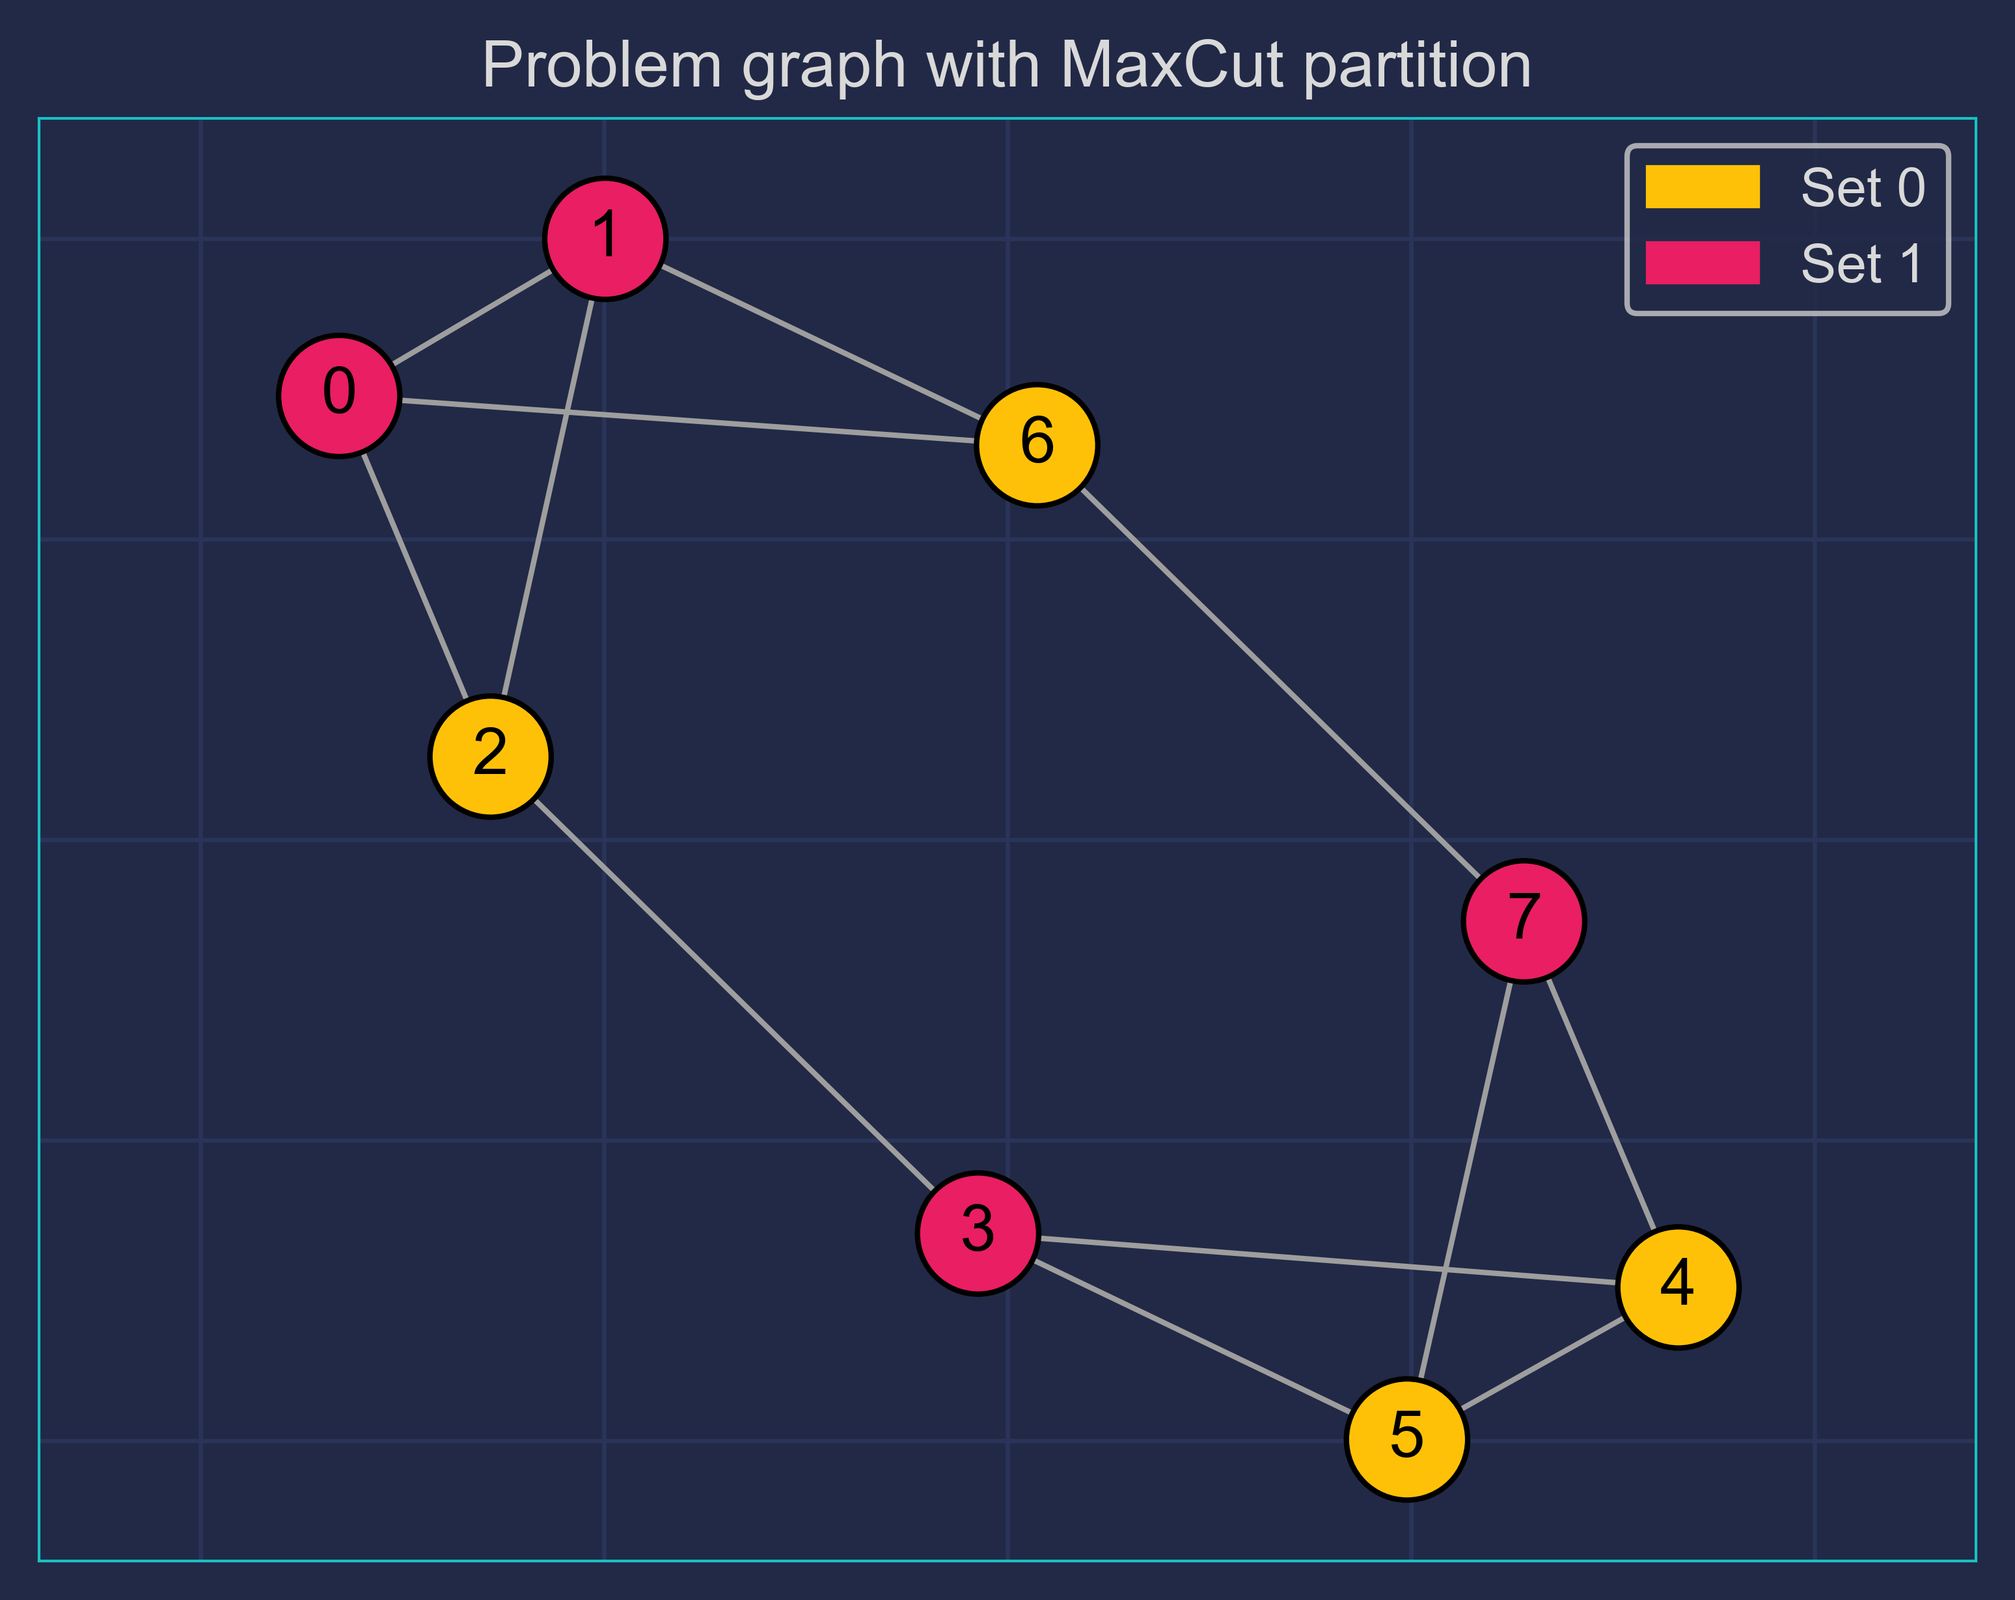
Problem graph

Slide 21
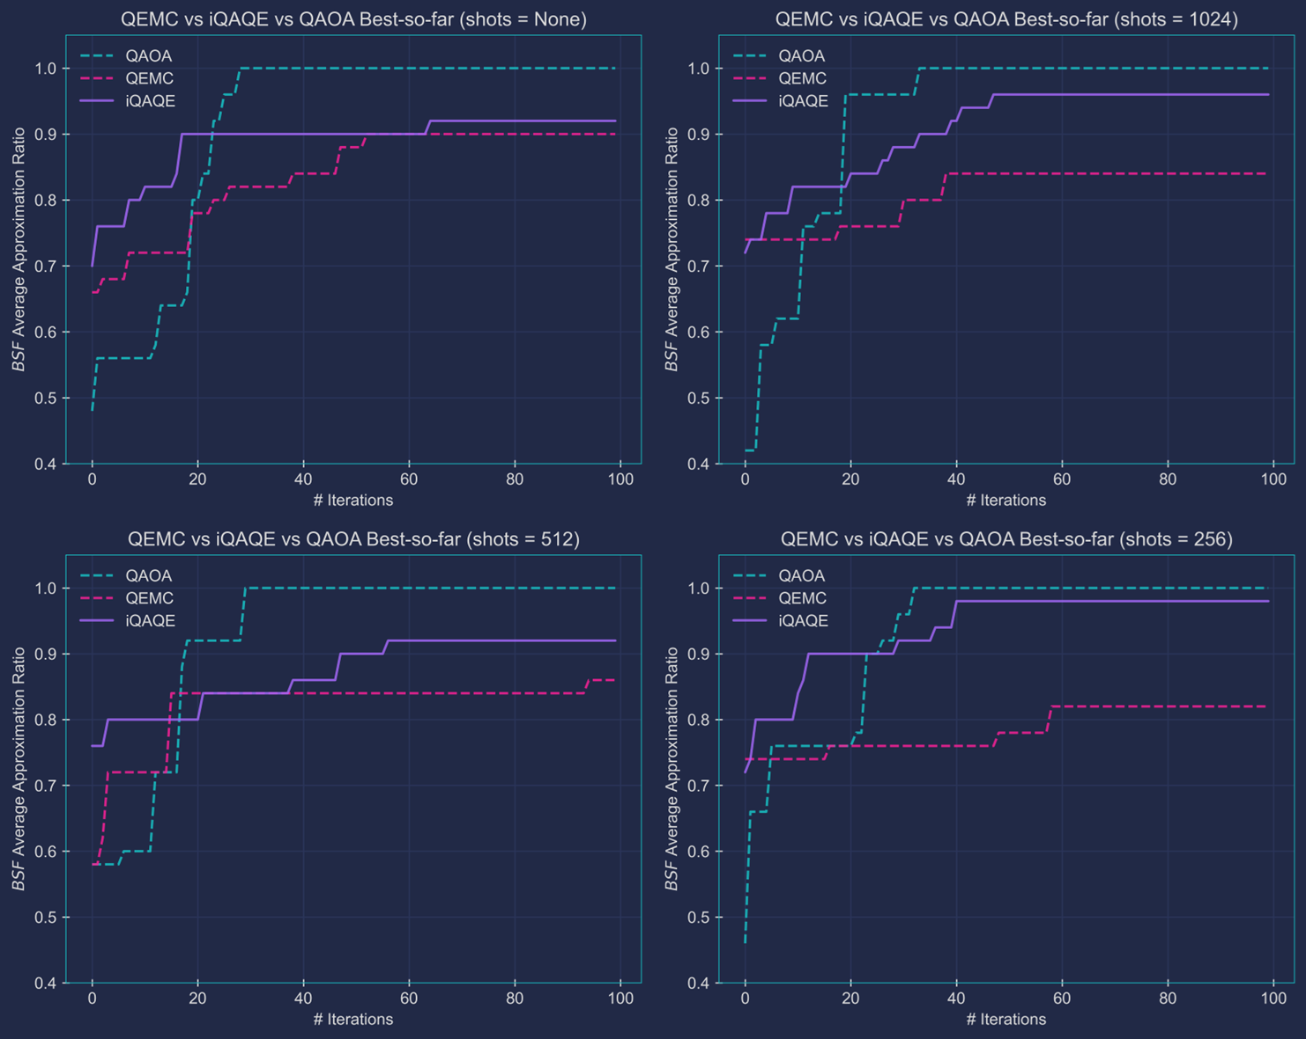
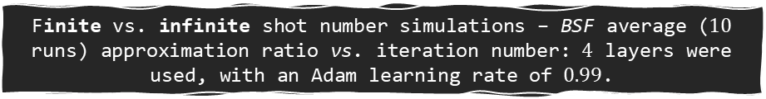
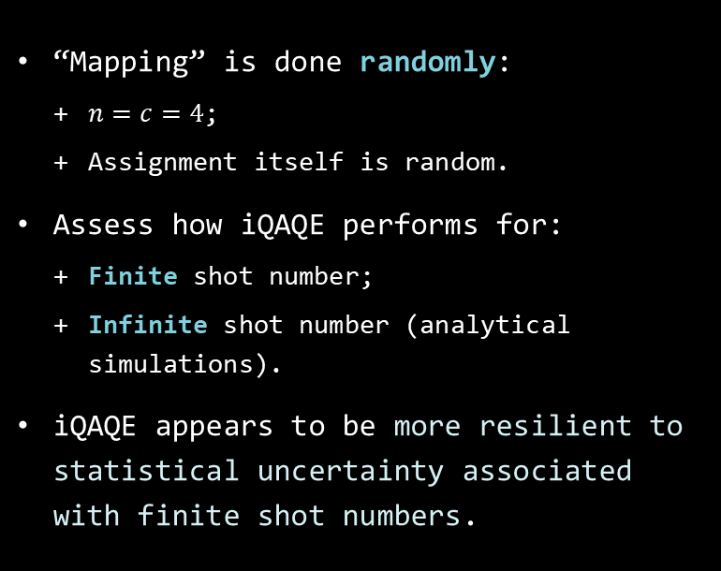
Random iQAQE
Simulation results:
“Mapping” is done randomly:
$n=c=4$;
Assignment itself is random.
Assess how iQAQE performs for:
Finite shot number;
Infinite shot number (analytical simulations).
iQAQE appears to be more resilient to statistical uncertainty associated with finite shot numbers.
Finite vs. infinite shot number simulations – BSF average ($10$ runs) approximation ratio vs. iteration number: $4$ layers were used, with an Adam learning rate of $0.99$.

Slide 22
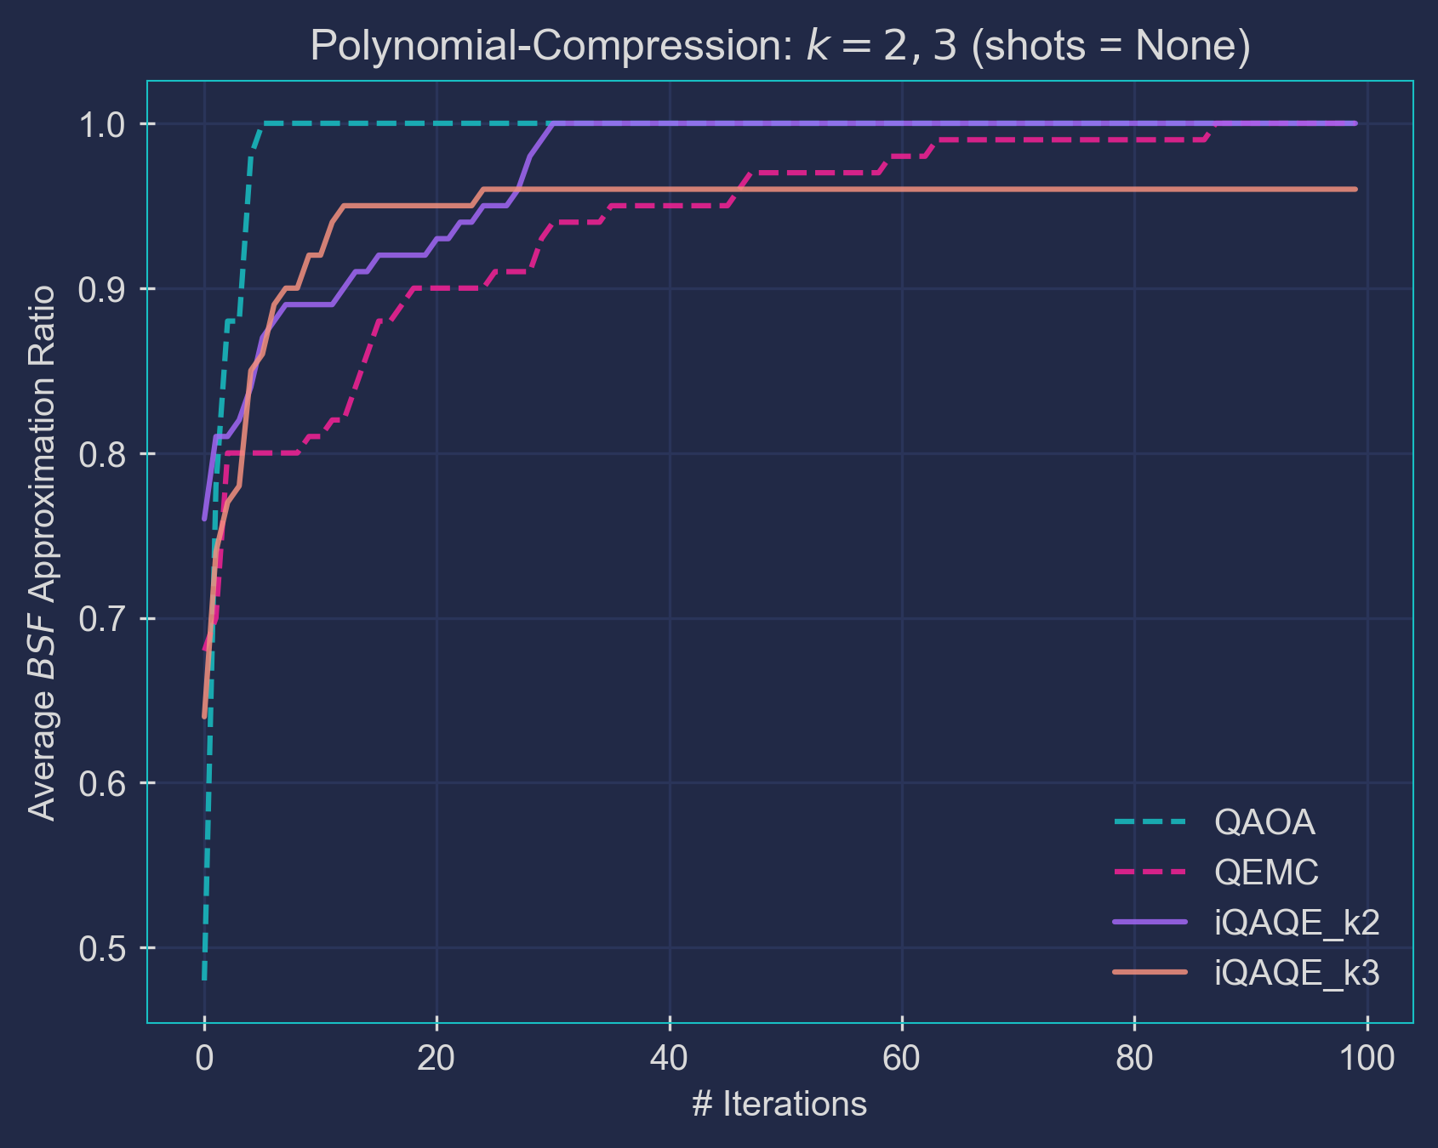
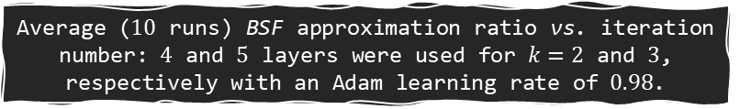
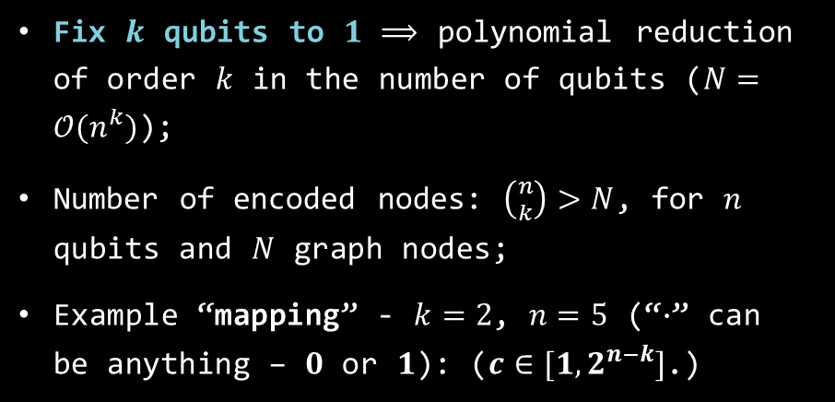


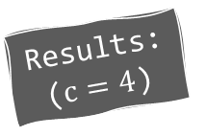
Basic polynomial compression-type iQAQE
Results: ($c=4$)
Fix $k$ qubits to $1$ ⟹ polynomial reduction of order $k$ in the number of qubits ($N=𝒪(n^{k})$);
Number of encoded nodes: $\left({n \atop k}\right)>N$, for $n$ qubits and $N$ graph nodes;
Example “mapping” - $k=2$, $n=5$ (“$∙$” can be anything – $0$ or $1$): ($c∈[1, 2^{n−k}]$.)
$\{|11∙ ∙ ∙⟩\}$;
$\{|1∙1∙ ∙⟩\}$;
$\{|1∙ ∙1∙⟩\}$;
$\{|1∙ ∙ ∙1⟩\}$;
$\{|∙11∙ ∙⟩\}$;
$\{|∙1∙1∙⟩\}$;
$\{|∙1∙ ∙1⟩\}$;
$\{|∙ ∙11∙⟩\}$;
$\{|∙ ∙1∙1⟩\}$;
$\{\left|∙ ∙ ∙11\right\rangle \}$.
$$\left({5 \atop 2}\right)=10>8$$
Average ($10$ runs) BSF approximation ratio vs. iteration number: $4$ and $5$ layers were used for $k=2$ and $3$, respectively with an Adam learning rate of $0.98$.

Slide 23
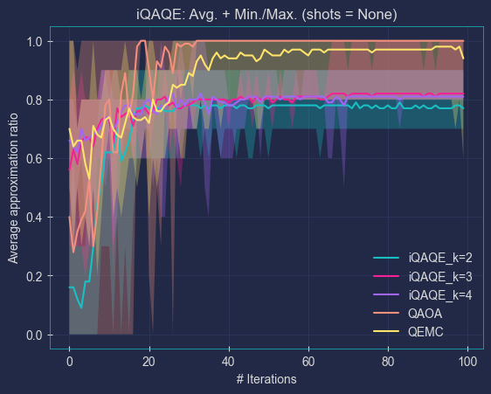
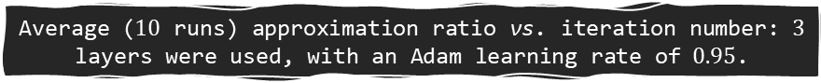
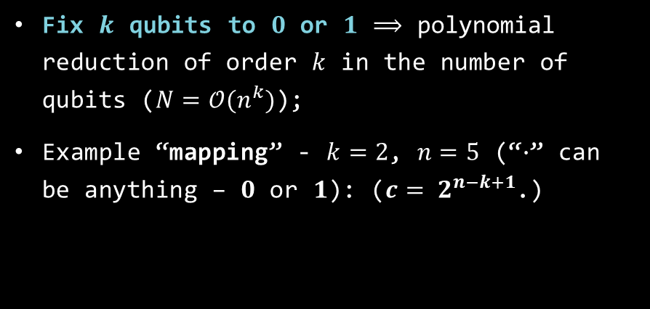



Correlation-based iQAQE
Results:
Fix $k$ qubits to $0$ or $1$ ⟹ polynomial reduction of order $k$ in the number of qubits ($N=𝒪(n^{k})$);
Example “mapping” - $k=2$, $n=5$ (“$∙$” can be anything – $0$ or $1$): ($c= 2^{n−k+1}$.)
Underperformance due to the $50\%$ overlap between pairs of sub-lists:
$\text{Overlap}=\frac{{2×2}^{n−k−1}}{{2×2}^{n−k}}=2^{−1}=50\%$.
Excessive overlap makes it hard to adjust one node’s probability without affecting other nodes’ probabilities.
$\{\left|11∙ ∙ ∙\right\rangle ,\left|00∙ ∙ ∙\right\rangle \}$;
$\{\left|1∙1∙ ∙\right\rangle ,\left|0∙0∙∙\right\rangle \}$;
$\{\left|1∙ ∙1∙\right\rangle ,\left|0∙ ∙0∙\right\rangle \}$;
$\{\left|1∙ ∙ ∙1\right\rangle ,\left|0∙ ∙ ∙0\right\rangle \}$;
$\{\left|∙11∙ ∙\right\rangle ,\left|∙00∙ ∙\right\rangle \}$;
$\{\left|∙1∙1∙\right\rangle ,\left|∙0∙0∙\right\rangle \}$;
$\{\left|∙1∙ ∙1\right\rangle ,\left|∙0∙ ∙0\right\rangle \}$;
$\{\left|∙ ∙11∙\right\rangle ,\left|∙ ∙00∙\right\rangle \}$;
$\{\left|∙ ∙1∙1\right\rangle ,\left|∙ ∙0∙0\right\rangle \}$;
$\left\{\left|∙ ∙ ∙11\right\rangle ,\left|∙ ∙ ∙00\right\rangle \right\}.$
Average ($10$ runs) approximation ratio vs. iteration number: $3$ layers were used, with an Adam learning rate of $0.95$.
$$\left({5 \atop 2}\right)=10>8$$
Notes:
Remember to say that the “shaded regions” represent the maximum and minimum obtained approximation ratios/cuts, out of the 10 runs, for each iteration value.

Slide 24




Fixed-parity iQAQE
Results:
Fix the parity of $k$ qubits to be even ⟹ polynomial reduction of order $k$ in the number of qubits ($N=𝒪(n^{k})$);
Example “mapping” - $k=3$, $n=5$ (“$∙$” can be anything – $0$ or $1$): ($c=\sum_{i=0}^{\left\lfloor k/2\right\rfloor }{\left({k \atop 2i}\right)×2^{n−k}}$.)
$\{\left|000∙ ∙\right\rangle ,\left|011∙ ∙\right\rangle ,\left|101∙ ∙\right\rangle ,\left|110∙ ∙\right\rangle \}$;
$\{\left|00∙ ∙0\right\rangle ,\left|01∙ ∙1\right\rangle ,\left|10∙ ∙1\right\rangle ,\left|11∙ ∙0\right\rangle \}$;
$\{\left|0∙ ∙00\right\rangle ,\left|0∙ ∙11\right\rangle ,\left|1∙ ∙01\right\rangle ,\left|1∙ ∙10\right\rangle \}$;
$\{\left|∙ ∙000\right\rangle ,\left|∙ ∙011\right\rangle ,\left|∙ ∙101\right\rangle ,\left|∙ ∙110\right\rangle \}$, etc.
Average ($10$ runs) approximation ratio vs. iteration number: $3$ layers were used, with an Adam learning rate of $0.95$.
$$\left({5 \atop 2}\right)=10>8$$
Notes:
Explain what “parity” is! “Parity [of a basis state] is determined by the number of ‘1’s: if the count is even, the parity is even; otherwise, it is odd.”

Slide 25


Unmodified extended-QEMC
Results:
$QEMC+ m$ additional qubits (beyond the usual $\left\lceil \log_{2}{(N)}\right\rceil$, for $N$ graph nodes);
Increase in qubit number prevents the scheme from being easily classically simulable;
Instead of $1$ basis state per list, this scheme uses $2^{m}$ non-overlapping basis states per list;
Example “mapping”:
First $2^{m}$ basis states (starting in ${\left|0\right\rangle }^{⊗n}$) go to the first node;
Second $2^{m}$ go to the second node, etc.
Average ($10$ runs) approximation ratio vs. iteration number: $3$ layers were used, with an Adam learning rate of $0.95$.
Notes:
Explain the advantages of having more basis states per list: more knobs to turn; more ways (i.e., parameter combinations) to achieve the MaxCut partition. Additionally, notice how we do not go beyond m = 5: that is simply because this would exceed the number of qubits used in QAOA. Also, explain the “(starting in ${\left|0\right\rangle }^{⊗n}$)” part: what does this mean? Start in 0 and go on, in binary: $\left|000\right\rangle$, $\left|001\right\rangle$, $\left|010\right\rangle$, etc., for example, for 3 qubits. Present this as an extension to QEMC, naturally.

Slide 26





Alternative ansätze
Results:
More problem-informed ansätze;
Example: $ND−CNOT$ ($R_{x}$ rotation + $CNOT$ gate):
The parameterized $R_{x}$ gates allow for the $CNOT$’s control qubit to rotate in and out of the $|1⟩$ state;
Tentatively removes excess entanglement, introduced by the “Strongly Entangling Layers” ansatz.
Average ($10$ runs) approximation ratio vs. iteration number: $3$ ($2$) layers were used, with an Adam learning rate of $0.95$ ($0.5$), for $D−CNOT$-based schemes ($ND−CNOT$).
Notes:
I think just gloss over this really fast. Just use this as an excuse to introduce the ND-CNOT-based schemes, which appear in the next slide’s plots, so that we know what we’re talking about. We don’t want that scheme to just appear out of nowhere.

Slide 27


Goemans-Williamson & bigger graphs
Notes:
Analysis, like I do in the “Extended Abstract”.

Slide 28
Conclusions and future work
iQAQE Framework:
Reduced qubit requirements;
Enhanced resilience to finite shot noise;
Competitive with classical state-of-the-art (Goemans-Williamson).
Future work:
Machine-learning-based “mapping” model;
Alternative schemes:
Parity-like QAOA;
Batch-based Oracle coloring.
iQAQE:
Problem-informed ansätze;
New heuristics for better “mapping(s)”;
Scalability analysis, for larger graphs, etc.
Advantages:
Exploration – allows for building multiple, distinct VQAs.

Slide 29
Acknowledgements
This work was developed in collaboration with Zoltan Zimborás and Bence Bakó, from the Wigner Research Centre for Physics (Hungary), in the context of project: HQCC – Hybrid Quantum-Classical Computing, supported by the EU QuantERA ERANET Co-fund in Quantum Technologies and by FCT – Fundação para a Ciência e a Tecnologia (QuantERA/004/2021). Additionally, I would like to thank my research supervisor, Yasser Omar, and my colleague, Miguel Murça, for their invaluable guidance in this project.

Slide 30
Main bibliography
[1] M. Cerezo, Andrew Arrasmith, Ryan Babbush, Simon C. Benjamin, Suguru Endo, Keisuke Fujii, Jarrod R. McClean, Kosuke Mitarai, Xiao Yuan, Lukasz Cincio, and Patrick J. Coles. “Variational quantum algorithms”. Nature Reviews Physics, 3(9):625–644, August 2021;
[2] Edward Farhi, Jeffrey Goldstone, and Sam Gutmann. “A quantum approximate optimization algorithm”, 2014, ArXiv: 1411.4028;
[3] Yovav Tene-Cohen, Tomer Kelman, Ohad Lev, and Adi Makmal. “A variational qubit-efficient maxcut heuristic algorithm”, 2023, ArXiv: 2308.10383;
[4] Michel X. Goemans and David P. Williamson. “Improved approximation algorithms for maximum cut and satisfiability problems using semidefinite programming”. J. ACM, 42(6):1115–1145, nov 1995;
[5] M.A. Nielsen and I.L. Chuang. “Quantum Computation and Quantum Information: 10th Anniversary Edition”. Cambridge University Press, 2010;
[6] Marco Sciorilli, Lucas Borges, Taylor L. Patti, Diego Garc´ıa-Mart´ın, Giancarlo Camilo, Anima Anandkumar, and Leandro Aolita. “Towards large-scale quantum optimization solvers with few qubits”, 2024, 2401.09421;
[7] Andrew Lucas. “Ising formulations of many np problems”. Frontiers in Physics, 2, 2014

Slide 31

Back-up slides

Slide 32

Basic polynomial compression-type iQAQE
Notes:
Difference between “BSF Average A.R.” and “Average BSF A.R.”, and what can be inferred from this? QEMC & iQAQE are “typically more sensitive to fluctuations in their performance curves, hinting at a more complex optimization landscape”. (Make this connection clear, in my reasoning/explaining.)

